Slide 1

Sentiment Analysis with Emotion Based Audio Player
Under the supervision of
Mrs.G.Sirisha,M.tech
N.Srilekha -17BQ1A12B2
K.Neshma -17BQ1A1266
L.Kavya sri -17BQ1A1291

Slide 2
Abstract:
Sentiment analysis is the use of natural language processing
analysis to systematically identify, extract and study affective
states of information. It plays an important role in extraction of an
individual’s behavior and emotional state. Based on the type of
emotions captured by the inbuilt camera, the playlist in the audio
player will be opened and played. If we want, we can also play songs
in the background.

Slide 3
Introduction:
Music is an important entertainment medium for with advancement
of technology, the optimization of manual work has gained a lot of
attention. Currently, there are many traditional music players that
require songs to be manually selected and organized. User, have to
create and update play list for each mood, which is time consuming.
Although some of these features are enjoyable for user, there is room
to improve in the field of automation when it comes to music players.
Selecting songs automatically and organizing these based on the
user’s mood gives user’s a better experience.

Slide 4
Existing System:
There are many existing music player applications. Some of the
interesting applications among them are:
Gaana, Saavan, Spotify – These application gives good user
accessibility features to play songs and recommends user with other
songs of similar genre.
Limitations of existing system:
It requires the user to manually select the songs.
Randomly played songs may not match the mood of the user.

Slide 5
Proposed System:
We consider the notion of collecting human emotion from
the user’s expressions, and explore how this information
could be used to improve the user’s experience with audio
players. We present a new emotion based and user interactive
music system.Proposed System aims to provide user preferred
music based on emotion by recognising face expressions.
Based on user emotions, songs related to that emotion will be
played.

Slide 6
Design Aspects:
Domain name: Social network analysis
Programming languages : Python
Tools: Visual Studio.

Slide 7
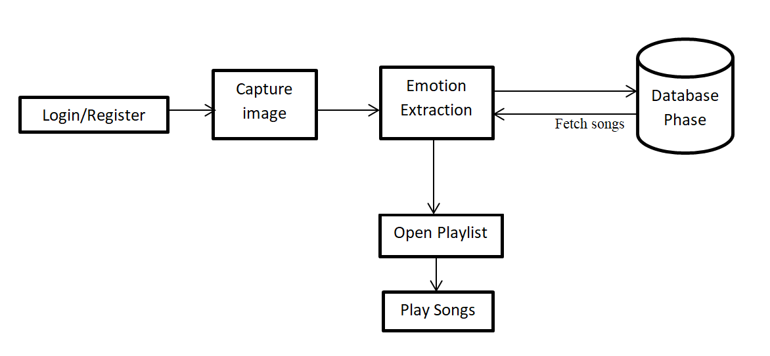
Architecture:

Slide 8
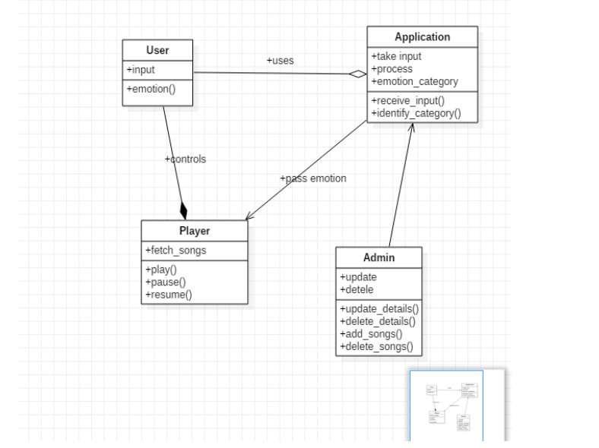
Class diagram:

Slide 9
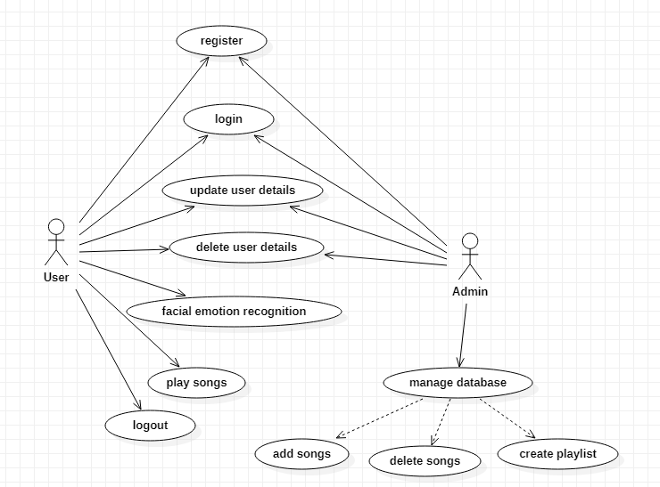
Use-case diagram:

Slide 10
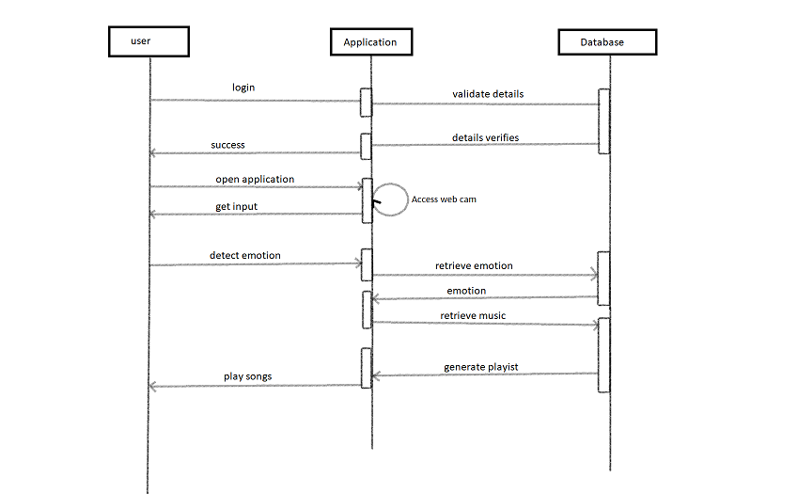
Sequence diagram:

Slide 11
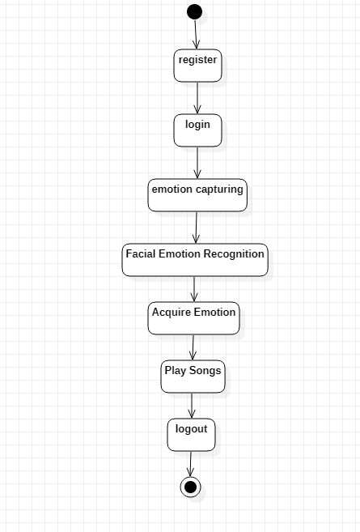
Activity diagram:

Slide 12
Modules:
Capture image
Emotion extraction
Audio Integration
Play songs

Slide 13

Capturing image:
The audio player appears and opens device’s camera to capture the emotion.
All these process are carried out in the backside of the music player.

Slide 14
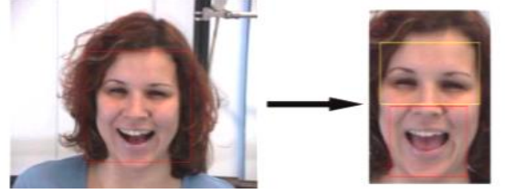
Emotion extraction:
After the picture is captured by the inbuilt camera, the captured image is used to detect the image’s emotion.
The user’s emotion is extracted. The application supports four emotions: happiness, sadness, surprise, anger, neutral.

Slide 15
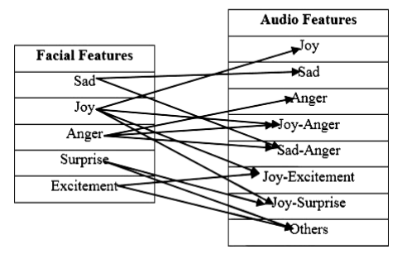
Audio Integration:
The emotion extraction module and audio feature extraction module is finally mapped and combined using an Emotion-Audio integration module.
For example, if an input facial image is categorized under joy, the system will display songs under joy, joy-anger, Joy-Excitement, Joy-surprise category.

Slide 16
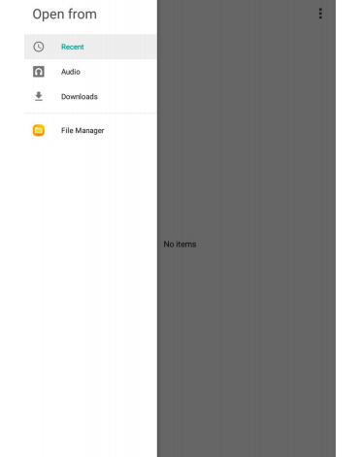
Open playlists:
In this module a list of songs forms the input.
According to the emotion of the user ,the playlists are opened and songs are played.

Slide 17
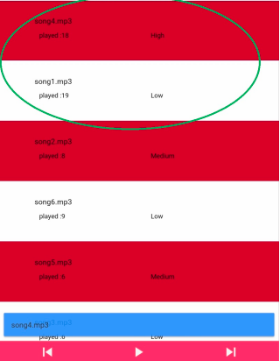
Output:
After capturing the image by the camera, emotion is detected and music player will start.
According to the emotion such as happy, sad, anger and neutral their playlists will be opened and songs are played.
Music player also has the features of playing the songs in queue mode, emotion mode and random mode.

Slide 18
Conclusion:
Emotion recognition is a rising trend which helps in reducing the
time involved in completing tasks.
This system helps the user by playing songs based on the users
facial expression.
Totally our work aims to develop a player which is based on user
need and it helps to revive in case of free time or leisure time if we
want to hear music based on our current situation.

Slide 19
THANK YOU

